Slide 3
Hum?

Slide 4
AAAAAH!!!

Slide 5
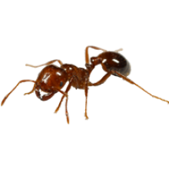

Slide 6
YOU JERKS HUNTED
DOWN MY FAMILY!
KILLED MY FRIENDS! ENDED THE HAPPY TIMES! SO NOW I WILL END YOUR LIFE!!!

Slide 7
FU…

Slide 8
We’re sorry, but in order to keep this game kid friendly we had to cut it there. Please forgive us.
Anyway, you won! YAAAAAAAAAAAAAAAAY!

