Slide 1
Bolle was an ritch buissnes man. He had just signed a deal with an… Strange ball. This ball was
Collecting fake coins. Bolle had bought an pack of valuable items for an large amount of these fake coins.

Slide 2
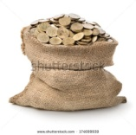
Balle was of in no-time, with a bag on the plaines tail!
He did not realize that the bag was open!

Slide 3
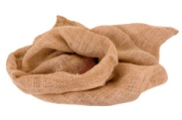
When bolle landed, he noticed that all of his fake coins had
been spred out all over the world! Paniced, in fear of
loosing his reputation of holding his word, he contacted his
manager for help.

Slide 4
Hey, jack! EEEEh… all my coins fell out of of the bag while i was flying. Where are they?
Oh, hello bolle! Well, good thing i added a radar to every coin! Lets se…

Slide 5
The coins are spread out ower three different regions of this world! That forest that is protected under some law, that lab country and a place full of lava. I reccomend that you just let it go! LET IT GO! It’s your rumor or your life!

