Slide 1
Bolle was an ritch buissnes man. He had just signed a deal with a… Strange ball. This ball was
collecting fake coins. Bolle had bought a pack of valuable items for a large amount of these fake coins.

Slide 2
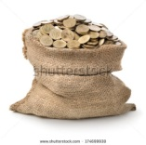
Bolle was off in no-time, with a bag on the plaines tail!
He did not realize that the bag was open!

Slide 3
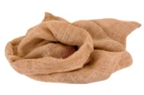
When Bolle landed, he noticed that all of his fake coins had
been spread out all over the world! Panicked, in fear of
loosing his reputation of holding his word, he contacted his
manager for help.

Slide 4
Hey, jack! EEEEh… all my coins fell out of the bag while I was flying. Where are they?
Oh, hello Bolle! Well, good thing I added a radar tracker to every coin! Lets se…

Slide 5
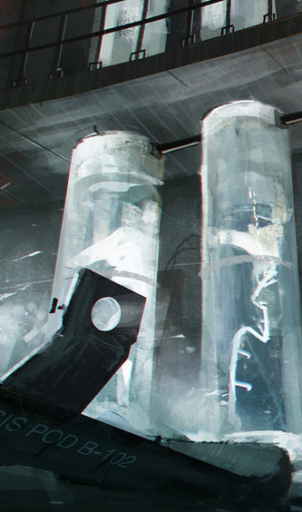
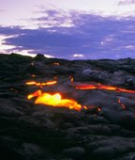
The coins are spread out over three different regions of this world! That forest that is protected under some law, that lab the size of a country and a place full of lava. I reccomend that you just let it go! LET IT GO! It’s your reputation or your life!

Slide 8
-Jack! Get me my jetpack, load on some fuel and bring my starwars-lazerblaster too! I’m going coin hunting!
-But…
-JUST DO IT! MAKE MY DREAM COME TRUE!!! JUST DO IT!!!

Slide 9
Well. Let’s go.

