Slide 1
What? What was that?
Bzzzzz…

Slide 3
Hello, mark!
Oh, hello, dan !
Well, there’s an strange
ball in the forest. We can’t
risk being caught, so do you
see what i mean?
Yes. He’s already dead!

Slide 4
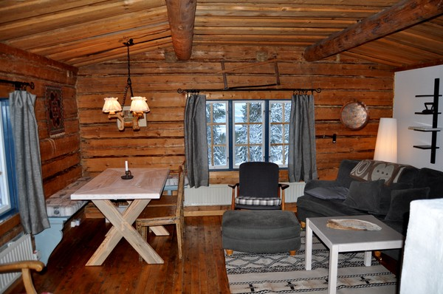
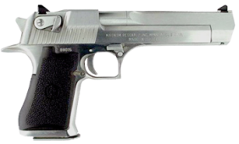
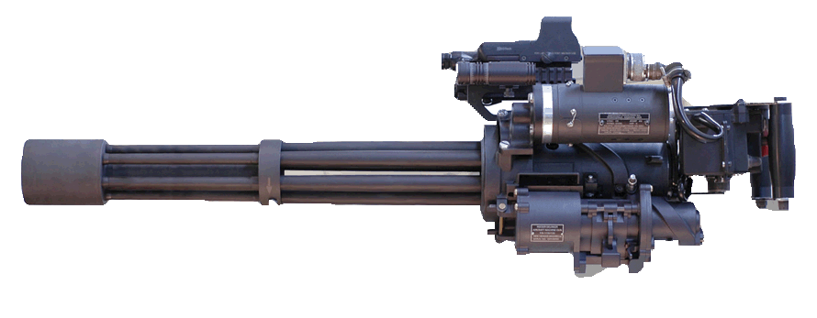
YES SIR!!!
Ssundie, crainer, get some guns!
We’re going ball hunting!

Slide 6
Really? That’s all you left for me?
AN DESERT EAGLE? How am i going
to deal any damage with that?

Slide 7
We’re sorry, take the extra-strong
Jetpack instead, if that makes you
happier!

Slide 8
BUT WE NEED TO KILL THAT BALL NOW

