Slide 2
The Mushroom Man
Samples from my MiscCraft Mod

Slide 3
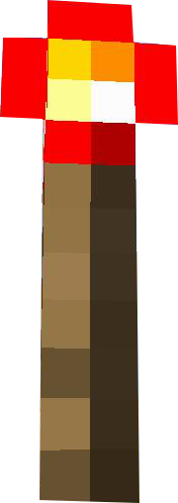
The Mushroom Man
Bolle

