Slide 1
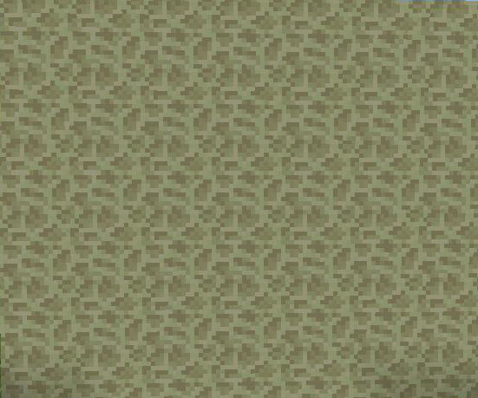

Slide 2
The Mushroom Man
Samples from my MiscCraft Mod

Slide 3

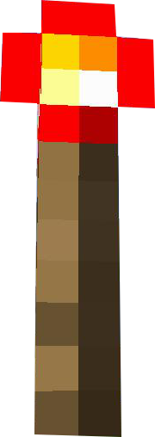

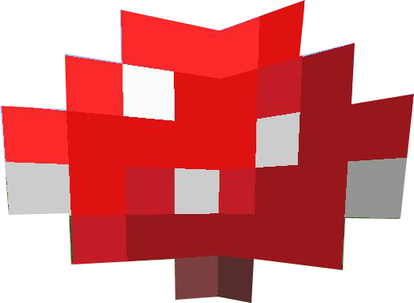
The Mushroom Man
Samples from my MiscCraft Mod

